Slide 1
BlockChain Princples
Vishal Yadav
vishal3152@gmail.com

Slide 2
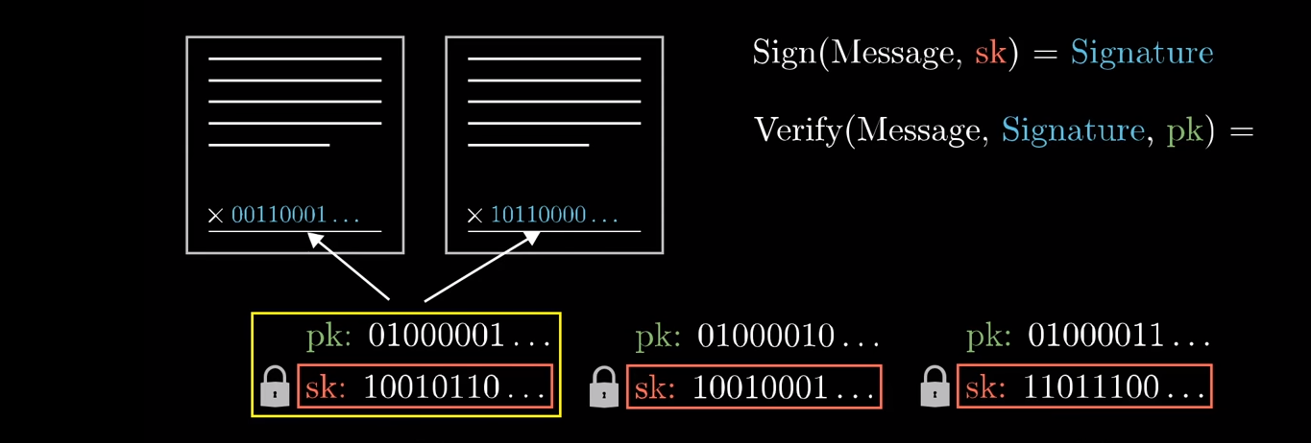
Digital Signature

Slide 3
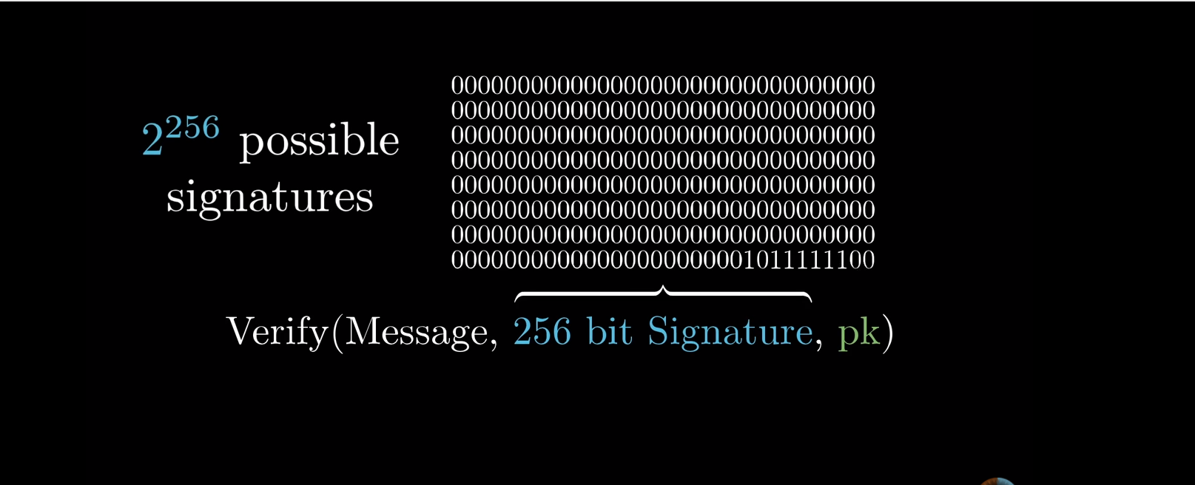
Digital Signature

Slide 4
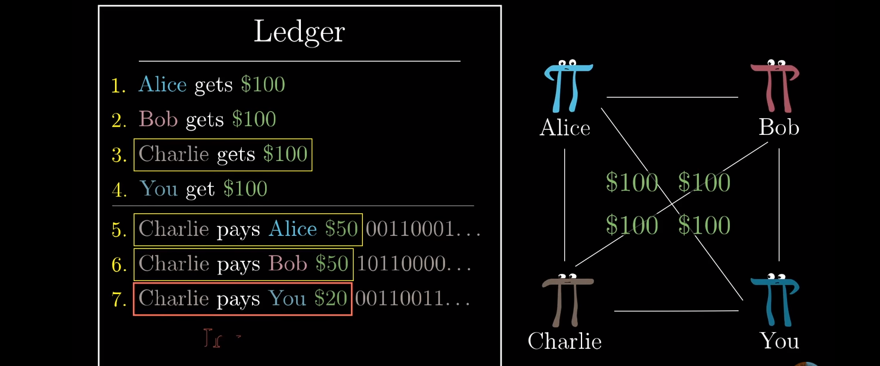
Transaction and Overspending

Slide 5
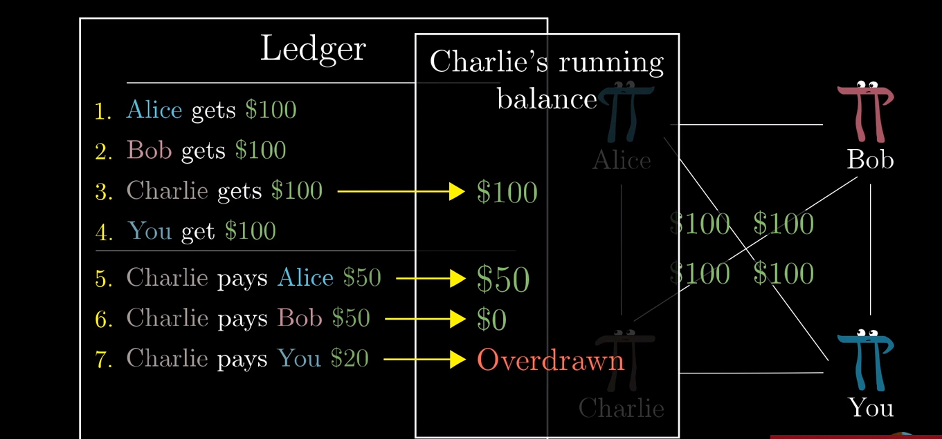
Transaction and Overspending

Slide 6
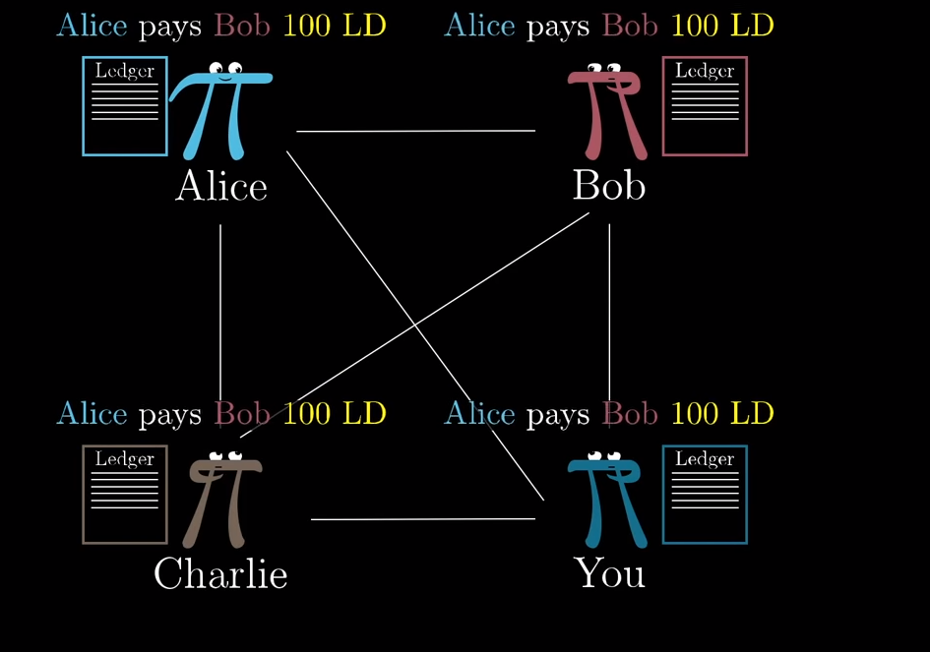
POW

Slide 7
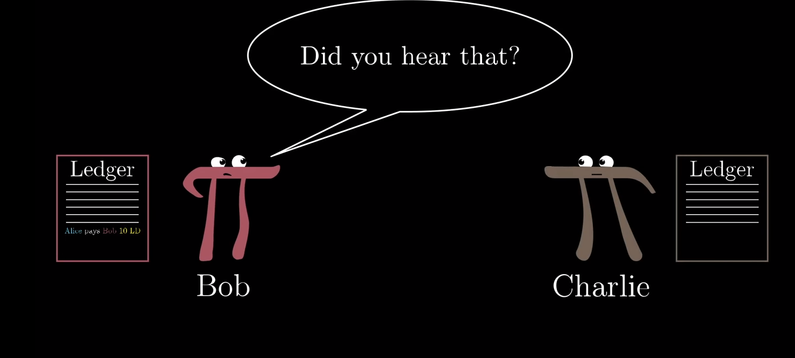
PoW

Slide 8
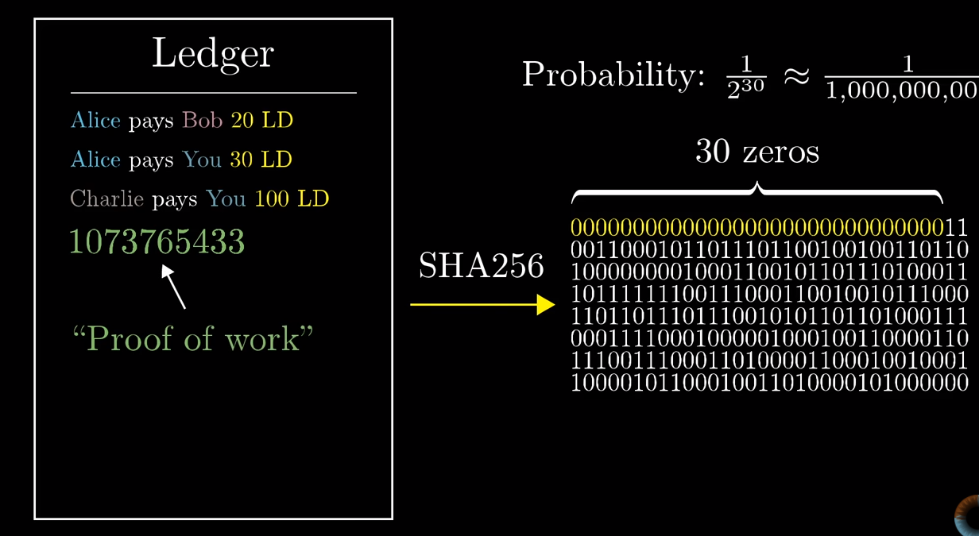
Consensus as PoW

Slide 9
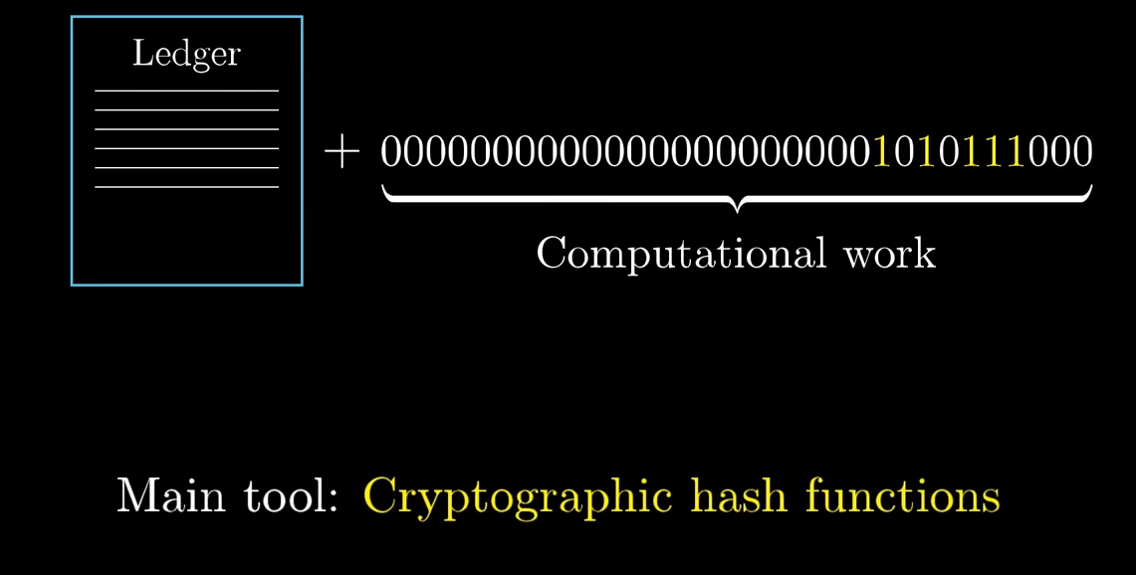
PoW

Slide 10
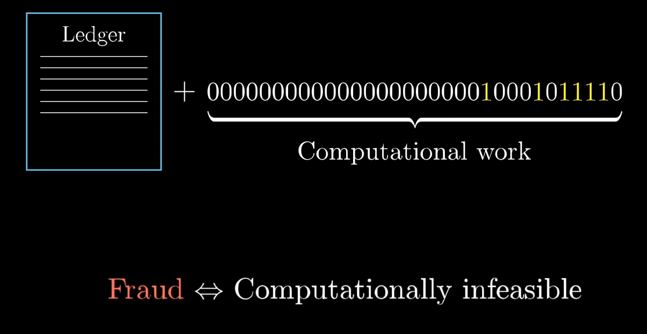
PoW

Slide 11
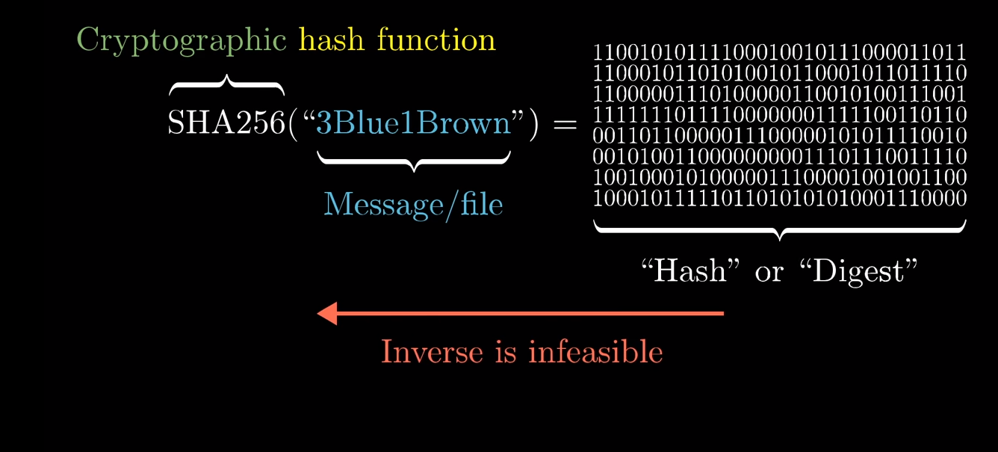
Consensus as PoW

Slide 12
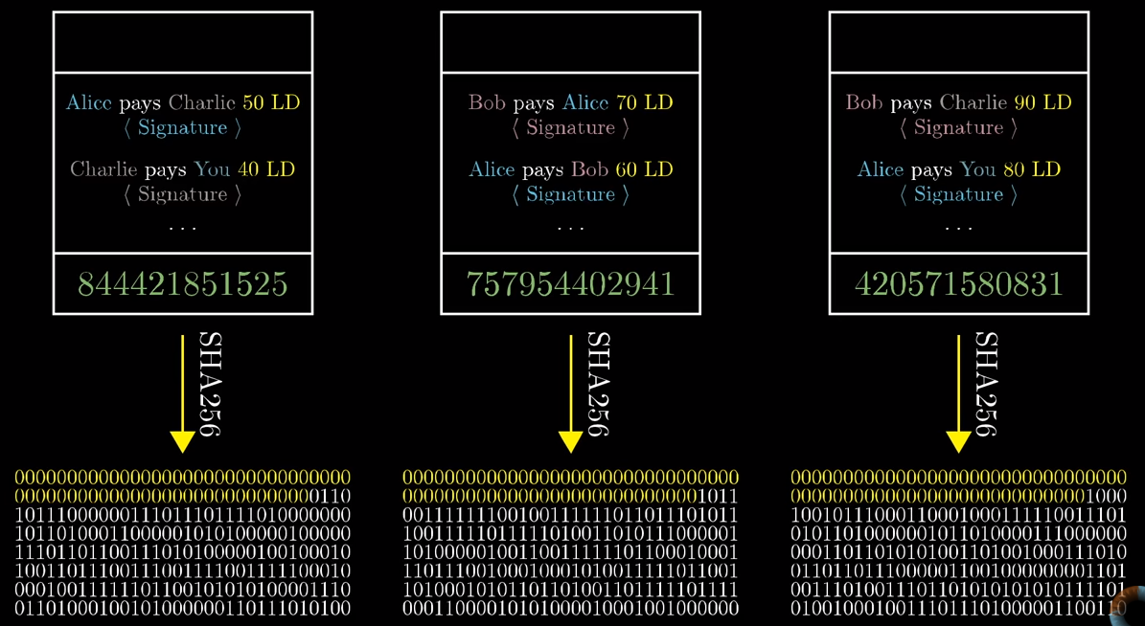
Block Creation

Slide 13
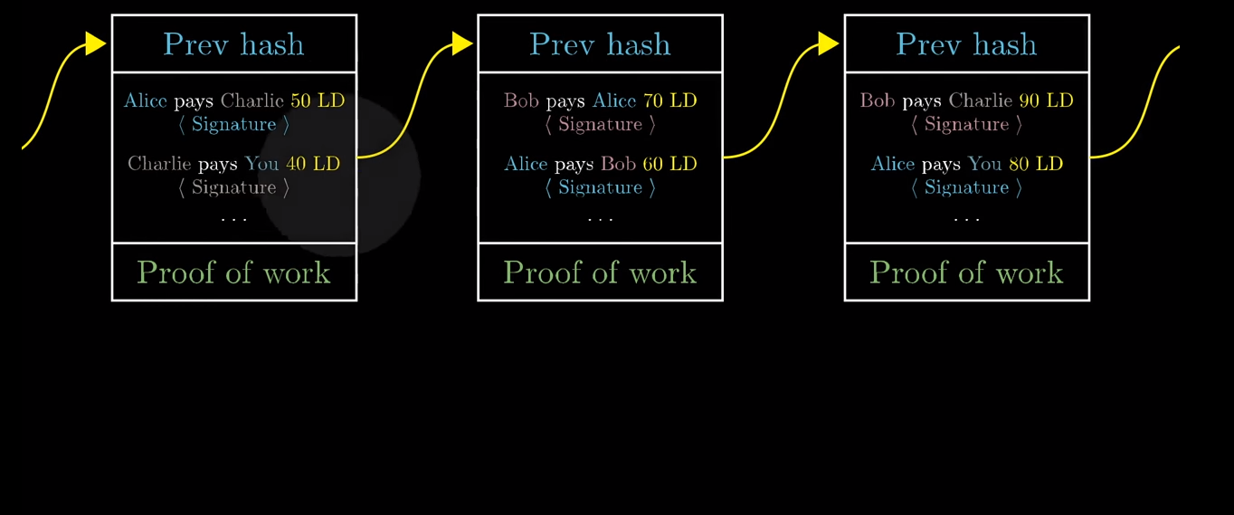
Block Creation

Slide 14
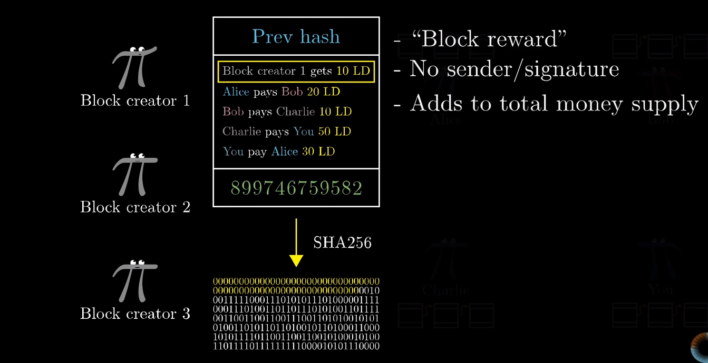
Block Mined

Slide 15
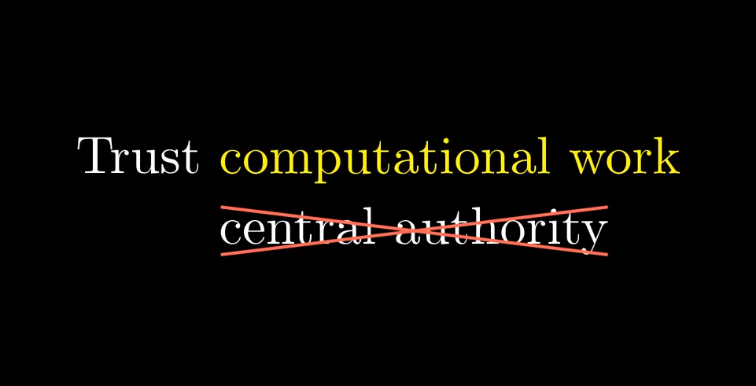

Slide 16
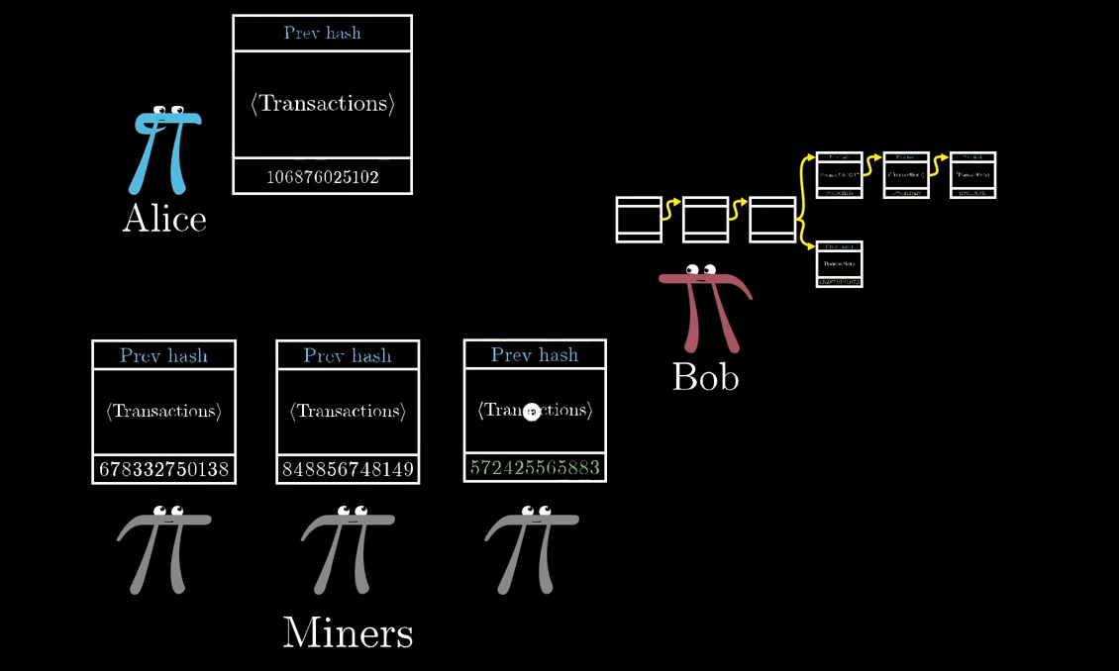
Handling Dishonest nodes

Slide 17
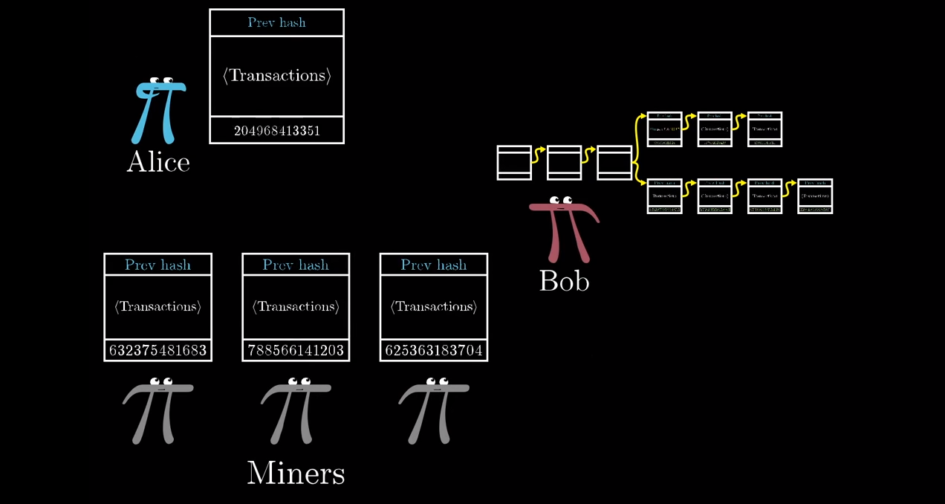
Handling Dishonest nodes

Slide 18
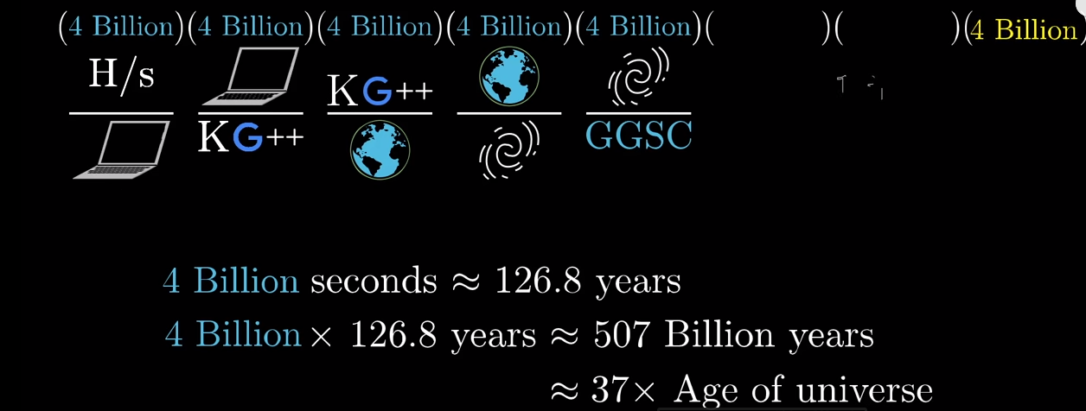
How complex is SHA-256

